Slide 1

Intake and Questionnaires Openloop | Medplum
2026.01.16

Slide 2




Why FHIR?
Fast Healthcare Interoperability Resources (FHIR) has emerged as the gold standard for healthcare data exchange. Here's why adopting FHIR matters for your organization:
Interoperability
Future Proof
Healthcare partners are increasingly exposing their data via FHIR APIs. Storing your data according to FHIR specifications smooths the path to interoperating with multiple partners and healthcare systems seamlessly.
The FHIR specification anticipates many complexities that arise in the healthcare domain, helping teams avoid costly backend rewrites and technical debt as requirements evolve.
Data Hygiene
While FHIR has a steep learning curve up front, enforcing good data hygiene from the start makes compliance, reporting, and billing significantly easier down the line.

Slide 3

Why FHIR?
Interoperability: Increasingly, healthcare partners are exposing their data via FHIR APIs. Storing your data according to FHIR spec smooths the path to interoperating with multiple partners
Future Proof: The FHIR spec anticipates many of the complexities that arise in the healthcare domain, helping teams avoid these backend rewrites.
Data Hygiene: FHIR has a steep learning curve up front, but enforcing good data hygiene up front makes compliance, reporting, and billing much easier down the line.

Slide 4
Resources
{
"resourceType": "Patient",
// Unique id for this resource
"id": "j_chalmers",
// Patient Name (could have multiple)
"name": [
{
"use": "official",
"family": "Chalmers",
"given": ["Peter", "James"]
}
],
// Phone + email info
"telecom": [
{
"system": "phone",
"value": "(03) 3410 5613",
"use": "mobile"
}
],
//…
}
Object Store: FHIR data is stored as JSON objects known as “resources”
Resource Types: 150+ Resource Types represent a broad range of healthcare concepts:
Concrete entities ( Patient, Medication, Device)
Abstract concepts ( Procedure, Care Plan, Encounter)
Id: All resources have an “id” field which serves as their unique identifier.
Medplum Resource Types: Medplum extends the FHIR spec with its own resources types, primarily related to Auth and User administration
https://www.medplum.com/docs/fhir-basics#storing-data-resources

Slide 5
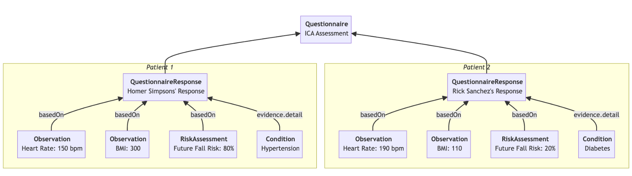
Parsing Questionnaires
Questionnaire: FHIR representation of a form
QuestionnaireResponse: a single instance of a response to a given Questionnaire
Best Practice: Power workflows with FHIR clinical data, rather than bespoke Questionnaires

Slide 6
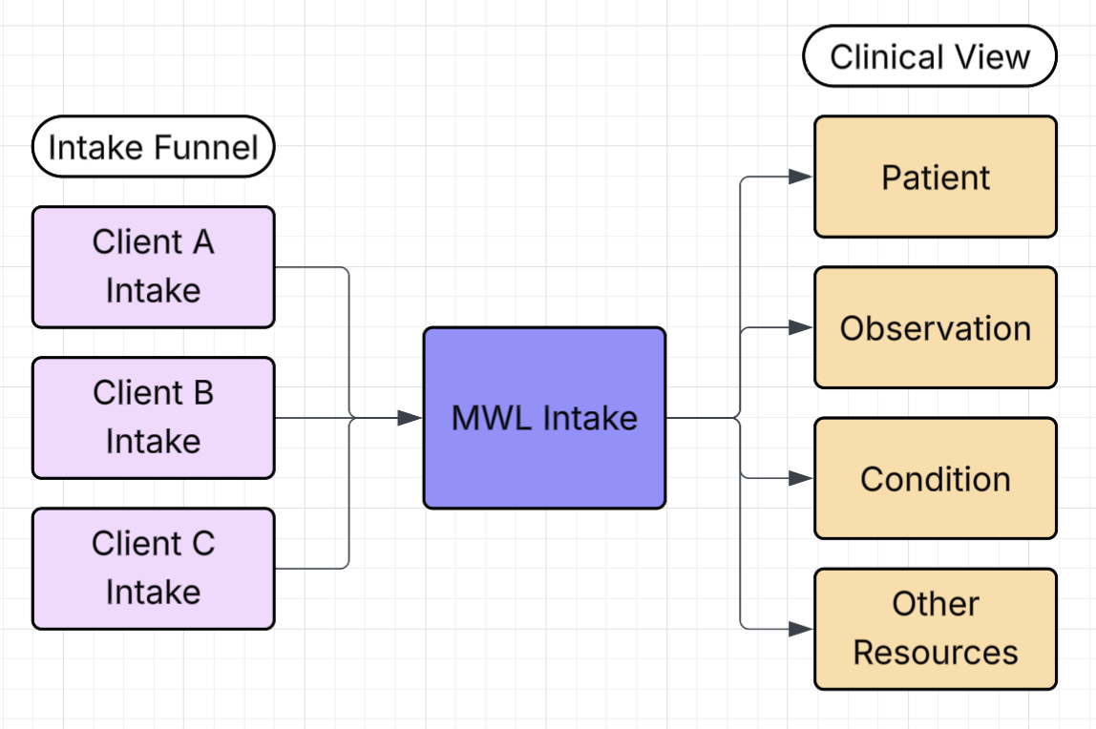
Key Intake Assumptions
Separate teams will own Intake Funnel and Clinical View.
Intake Funnel team is responsible for normalization into a Main Questionnaire, on a per-vertical basis.
Intake Funnel team will maintain client-specific intake inputs outside of Medplum.
Main Questionnaire will match question to Openloop Concept ID.
Clinical View team is responsible for parsing Main Questionnaire into data for clinical reasoning.

Slide 7
Separate teams will own Intake Funnel and Clinical View.
Key Intake Assumptions
Intake Funnel team is responsible for normalization into a Main Questionnaire, on a per-vertical basis.
Intake Funnel team will maintain client-specific intake inputs outside of Medplum.
Clinical View team is responsible for parsing Main Questionnaire into data for clinical reasoning.
Main Questionnaire will map one question to one Openloop Concept ID.

Slide 8
Example Main Questionnaire
{
"resourceType": "Questionnaire",
"name": "Main MWL Questionnaire",
"item": [
{
"id": "first-name",
"linkId": "openloop-conceptid-001",
"text": "First Name",
"type": "string",
"required": true
},
{
"id": "dob",
"linkId": "openloop-conceptid-050",
"text": "Date of Birth",
"type": "date"
},
{
"id": "height",
"linkId": "openloop-conceptid-105",
"text": "Patient's Height (in inches)",
"type": "integer"
}
]
}
linkId ties individual questions to Openloop Concept ID’s
Helps Clinical View team to ingest data in a consistent manner
Allows questions to be compared between client-specific intake
Enforces data consistency across Intake Questionnaires in multiple verticals by matching Concept ID’s

Slide 9
Storing Client-Specific Questionnaires
{
"resourceType": "Questionnaire",
"name": "Client A MWL Questionnaire",
"item": [
{
"id": "first-name",
"linkId": "openloop-conceptid-001",
"text": "Tell me your first name!",
"type": "string",
"required": true
},
{
"id": "dob",
"linkId": "openloop-conceptid-050",
"text": "When were you born?",
"type": "date"
},
{
"id": "height",
"linkId": "openloop-conceptid-105",
"text": "How tall are you, in inches?",
"type": "integer"
}
]
}
{
"resourceType": "Questionnaire",
"name": "Main MWL Questionnaire",
"item": [
{
"id": "first-name",
"linkId": "openloop-conceptid-001",
"text": "First Name",
"type": "string",
"required": true
},
{
"id": "dob",
"linkId": "openloop-conceptid-050",
"text": "Date of Birth",
"type": "date"
},
{
"id": "height",
"linkId": "openloop-conceptid-105",
"text": "Patient's Height (in inches)",
"type": "integer"
}
]
}
Bot

Slide 10
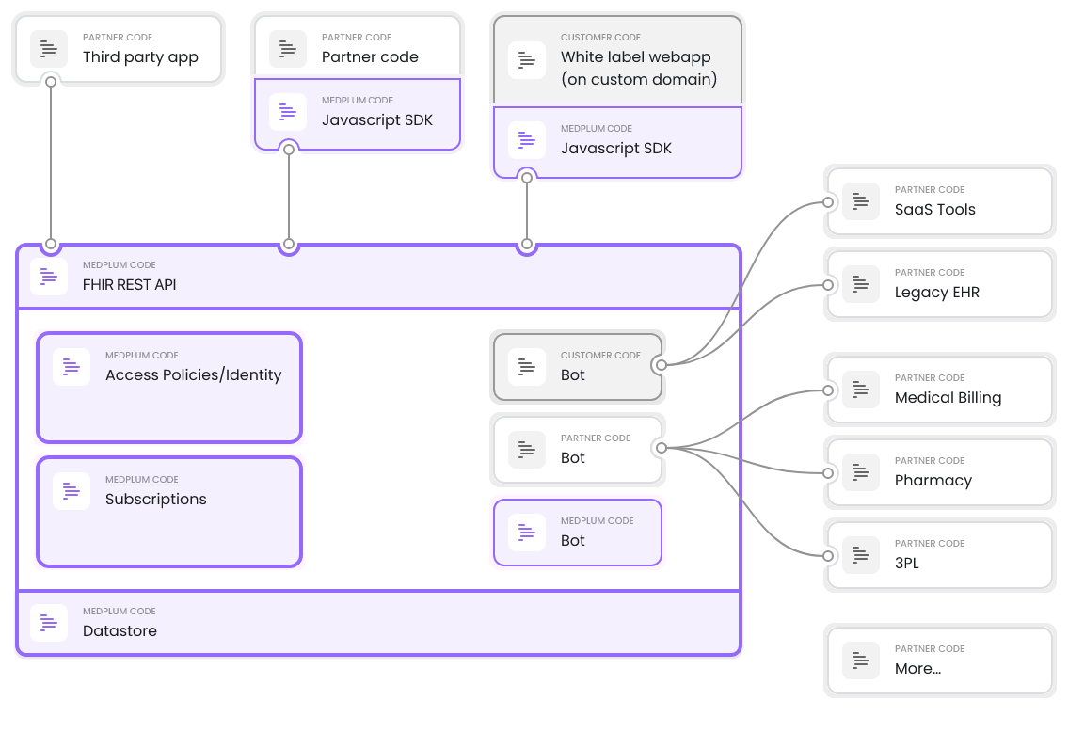
Medplum Architecture
https://www.medplum.com/docs/fhir-basics

Slide 11
Comparing Intake Across Verticals
{
"resourceType": "Questionnaire",
"name": "MWL Questionnaire",
"item": [
{
"id": "weight",
"linkId": "openloop-conceptid-106",
"text": "Patient’s weight (in pounds)",
"type": "decimal"
},
{
"id": "using-glp1",
"linkId": "openloop-conceptid-215",
"text": "Currently using a GLP-1",
"type": "choice" // GLP-1 list or None
},
{
"id": "mwl-comorbidities",
"linkId": "openloop-conceptid-110",
"text": "Comorbidities",
"type": "choice" // comorbidities
}
]
}
{
"resourceType": "Questionnaire",
"name": "TRT Questionnaire",
"item": [
{
"id": "libido",
"linkId": "openloop-conceptid-616",
"text": "Noticed change in libido",
"type": "boolean"
},
{
"id": "weight",
"linkId": "openloop-conceptid-106",
"text": "Patient's weight (in pounds)",
"type": "decimal"
},
{
"id": "trt-comorbidities",
"linkId": "openloop-conceptid-110",
"text": "Comorbidities",
"type": "choice" //comorbidities
}
]
}

Slide 12
Comparing Intake Across Verticals
{
"id": "mwl-comorbidities",
"linkId": "openloop-conceptid-110",
"text": "Comorbidities",
"type": "choice" // comorbidities
}
{
"id": "trt-comorbidities",
"linkId": "openloop-conceptid-110",
"text": "Comorbidities",
"type": "choice" //comorbidities
}
What happens if the relevant comorbidities list is different between verticals?
If patient fills out intake for two vertical at the same time, one may risk either having patient enter duplicate data (failure to complete), or not having complete data (clinical risk).
Recommendation: Each Openloop Concept ID corresponds to an atomic amount of data.
Atomic: smallest complete piece of data (i.e. has hypertension, does not have kidney disease)
If an existing patient wants medication from a new vertical, FHIR clinical data can power prefilling intake because each part of intake corresponds to an atomic amount of data

Slide 13
Medplum Recommendations
Create a Main Questionnaire per vertical
Clear handoff between Intake Funnel team and Clinical View teams.
Create client-specific Questionnaires in Medplum
Tracing: source-of-truth data is stored in Medplum.
Replay: if parsing changes, translation of client-specific to main Questionnaire can be replayed via API.
Infrastructure: Bots and Subscriptions handled by Medplum, Bot code can be checked in and deployed with source control and CI/CD.
Review Concept ID’s to ensure each ID stores an atomic amount of data
Verticals can share intake funnels.
Atomic data corresponds better to FHIR data, which can power prefilled intake.

